Slide 1
영상 처리의 실제
Image Processing

Slide 2
Chap4 Geometric Processes
modify arrangement of pixels by geometric transformation
forward vs inverse mapping

Slide 3
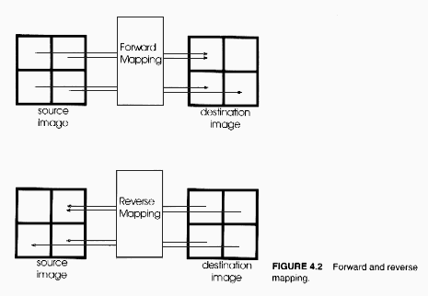

Slide 4
  forward mapping computes destination pixel for each source pixel
  problem of forward mapping
    holes and overlaps
  inverse mapping computes source pixel for each destination pixel

Slide 5
interpolation
  generate values for addresses that lie between pixels
nearest neighbor interpolation
  take pixel closest to computed address
  fast, but multiple output pixels may tie to one input pixel
bilinear interpolation
  get new pixel as a weighted sum of four nearest pixels
  require 3 linear interpolation

Slide 6
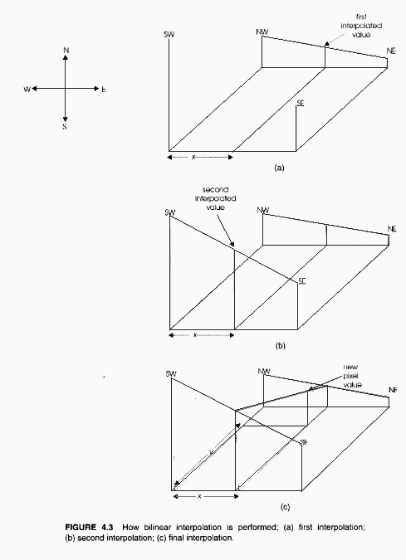

Slide 7
higher order interpolation
  center a weight function at point of interest and take sum of weighted sample values
  get 2D interpolation by first treating each row in 1D way and then interpolating resulting values in 1D way

Slide 8
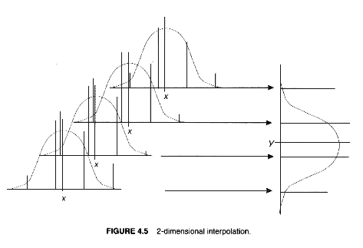

Slide 9
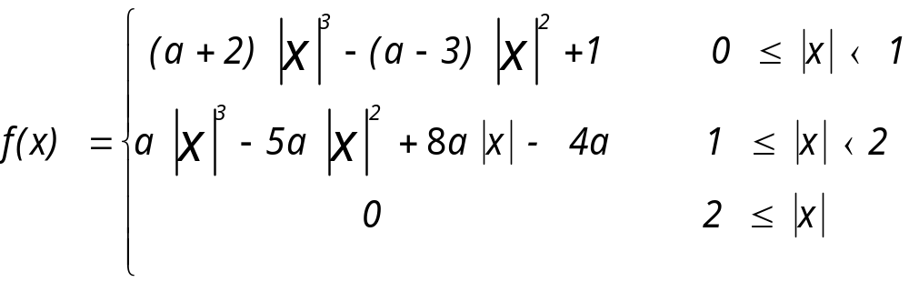
cubic convolution interpolation
  use interpolation (weight) function

Slide 10
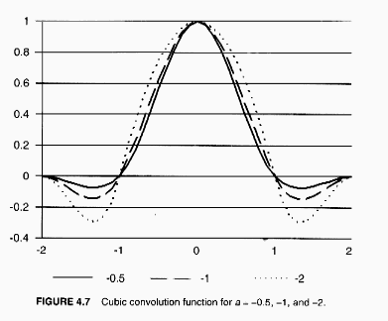

Slide 11
    do clipping for small and large values
    require 5 1D interpolations per pixel for an array of 16 image sample points

Slide 12
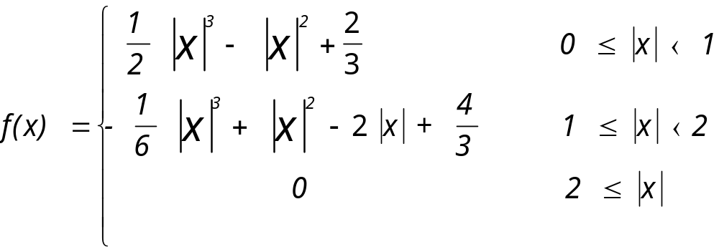
B-spline interpolation
  good low-pass filter
  sum of sample points of weight function is 1 --> no need of clipping operation

Slide 13
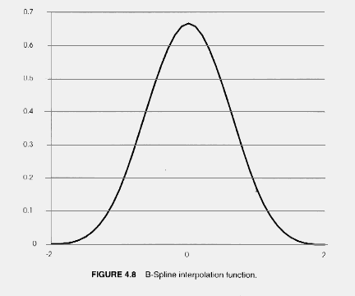

Slide 14
image scaling
  never improve upon original resolution
  every scaling operation degrades an image
    compute source addresses by dividing destination x and y by scaling factors
    determine pixel value by applying some interpolation technique

Slide 15
  scaling with NN interpolation
    magnify by pixel replication
    shrink by picking up some pixels out of scanline
    upscaling makes diagonal lines of scaled image very poor
    downscaling loses fine details
      as a remedy, do blurring before downdscaling

Slide 16
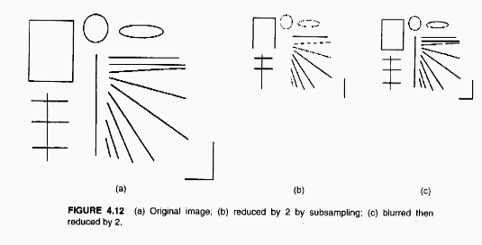
minification only techniques

Slide 17
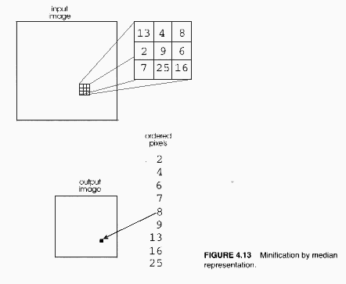
  median representation
    replace a block of pixels by their median value

Slide 18
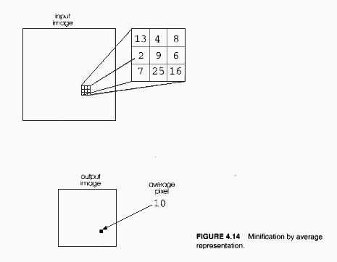
  average representation
    replace a block of pixels by their average
    faster than median representation

Slide 19
rotation
  Xsource = Xdest*cos(angle) + Ydest*sin(angle)
  Ysource = Xdest*cos(angle) - Ydest*sin(angle)
  may need interpolation when computing Xsource and Ysource

Slide 20
translation
  move a section of image to another location
  need two buffers to prevent possible overlap between source and destination window
mirroring
  flip an image about x or y axis

Slide 21
Chap5 Frame processes
addition
  compose new image by adding two old ones
subtraction
  make difference between two images
  possible application
    security system, visual inspection

Slide 22
AND/OR
  each bit of pixels are ANDed or ORed bit by bit
  ANDing often uses a mask of value 0
average
  sum two pixel values of two input images and divide the sum by two
  good when noise is uncorrelated
  human vision is believed to perform temporal averaging

Slide 23
Chap6 Digital Halftoning
introduction
  process of breaking continuous tones into patterns of black dots
  used for monochrome monitor and printer
  utilize illusion of human vision
  photographic vs digital halftoning

Slide 24
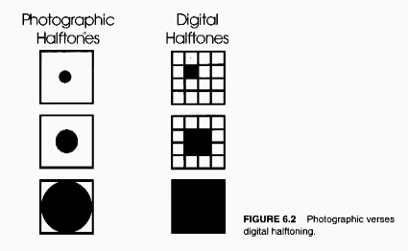

Slide 25
  halftoning parameters
    shape of grid -- square, circle, ellipse, hexagon
    density of lines on grid
      trade-offs between spatial resolution and intensity resolution
    screen angle
      prefer 45 degree rotated screen
  color halftoning
    separate image into 4 channel (CMYK) and use 4 haftone screens
      cyan screen at 15 degree,magenta at 75, yellow at 0 and black screen at 45 degree

Slide 26
patterning with 4X4 matrix
  represent each pixel by a block of cell
      input gray scale is converted into 17 output levels
  often used when output device has more spatial resolution than source image
      when output device has a resolution of 640X480, the effective resolution with 4X4 patterning matrix becomes 160X120
  need to choose carefully the patterns of printed cells
    Rylander’s recursive patterning matrix

Slide 27
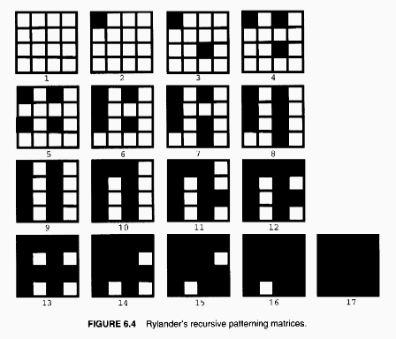
      each cell considered on at specific intensity must
      remain on for all greater intensities

Slide 28
dithering
  spatial resolution of output image is the same as that of source image
  generalized thresholding with dither matrix
    adjust input gray scale into 17 levels
    overlay dither matrix onto input
    print output dot everywhere input value is greater than matrix value

Slide 29
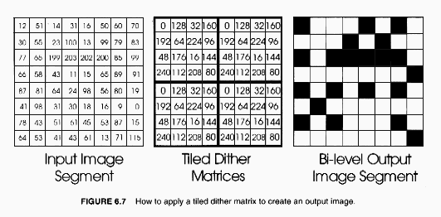

Slide 30
  dither matrix
    must be a growth sequence
      cell printed in a block for intensity i must be printed in blocks for intensities greater than i
    can be generated recursively, equation

Slide 31
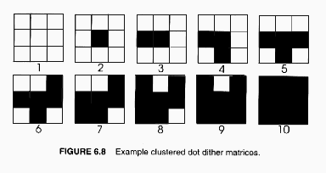

Slide 32
    clustered-dot ordered dither matrix
      used for film recorder and laser printer which have difficulty reproducing dots in isolated cells
      dot begins in the center cell and grows outward
      new dot must be adjacent to already printed dots
    45 degree dither matrix
      can be implemented as an extended rectangular dither matrix,

Slide 33
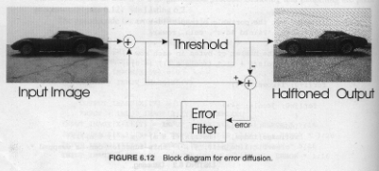
error diffusion
  spread quantization error of current pixel to nearby pixels

Slide 34
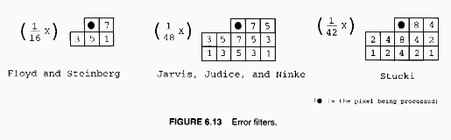
  can attach error weights which sum up to 1

Slide 35
  preserve sharp details, but produce artifact
    echoes or ghosts at image edges
      to eliminate echoes, do preprocessing an image
    avalanche, diagonal lines in regions of constant intensity
      scan in zigzag manner and distribute errors in alternating directions
beyond bilevel output
    use dithering for reducing intensity resolution
    color dithering for reducing 24 bit graphics to 8 bit graphics (3 for red, 3 for green, 2 for blue)
      tile dither matrix over each channel of input image

Slide 36
      add values and take most significant bits (3 for red)
        need to scale values in dither matrix ( they may span from 0 to 31 for removal of 5 bits)
    simple bit reduction of 8 bits of red to 3 bits by the finding closest pixel
      determine comparison values in father space(8 bit space); since 256/7=36.56, they become { 0, 36, 73, 109, 146, 182, 219, 255 }
      compare input red value with comparison values and find the closest one; for 44 of red, the closest one is 36 and 3 bit output becomes 1 (MSB of comparison value).
      error diffusion
        determine error to disperse & diffuse it to neighbors; for the above case, error is 44-36=8.

